Slide 1
Sample Output Screenshots
(and notes)

Slide 2
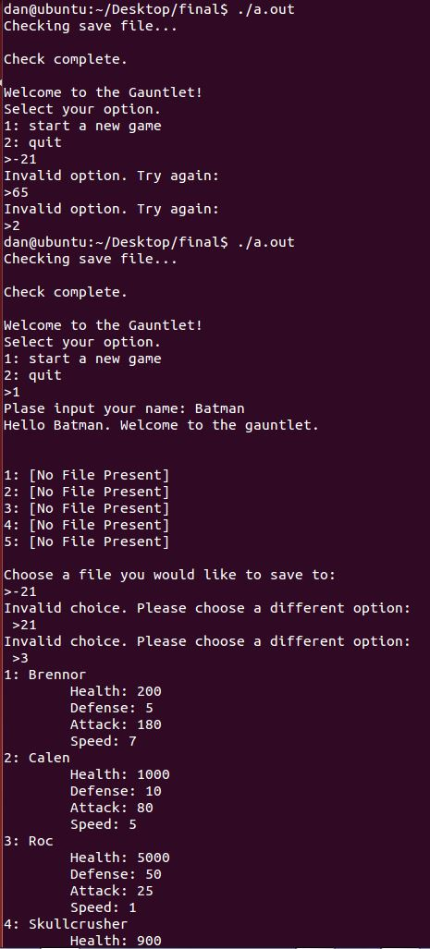
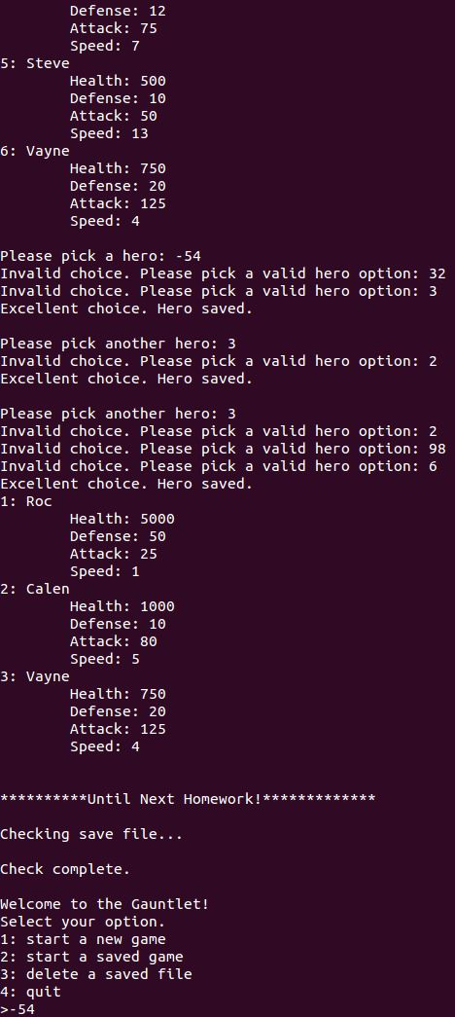
The output flows over to the top of the next picture.
Many things you see are as a result of the code prewritten for you. Find and pay attention to the pieces that relate to what you are writing.
Things you should look for:
How the main menu behaves
The heroes are sorted when they are printed out
There are various pieces of error checking on selecting the heroes
The program loops to the main menu after the chosen heroes are printed out
The main menu looks different because there is a save file

Slide 3
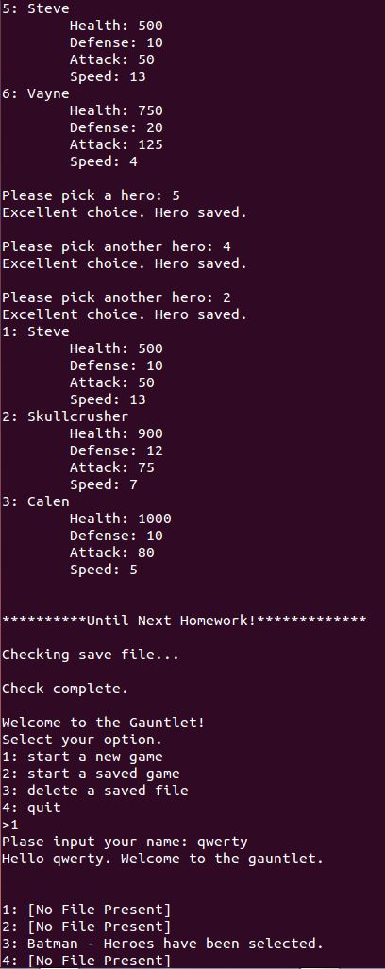
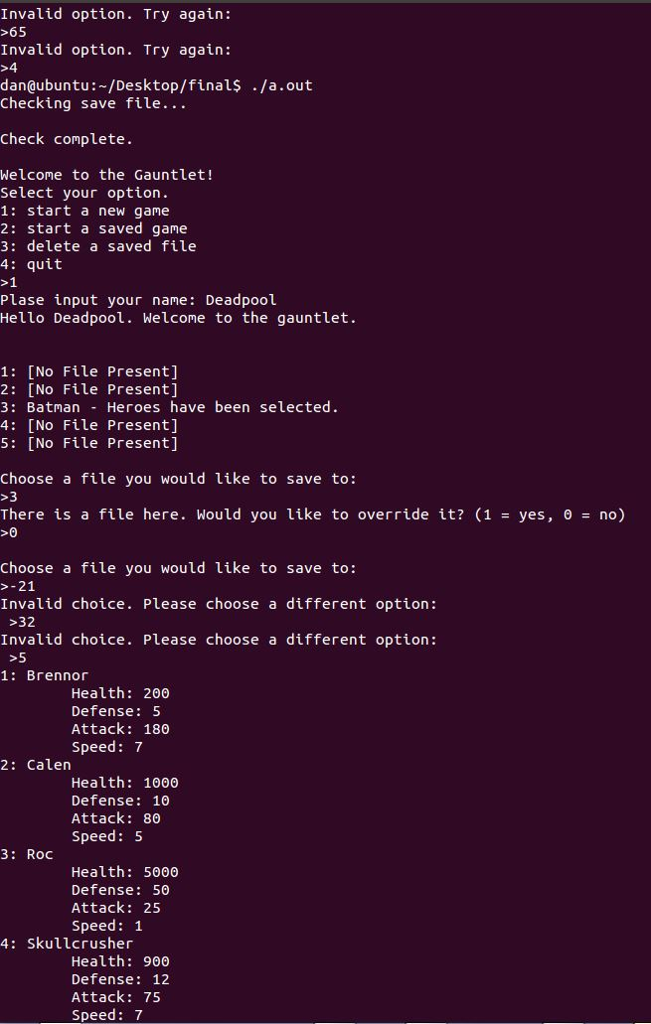
Things you should look for:
The gamestate.txt file changed because there is a save file, so you see the slot taken with the name and the status

Slide 4
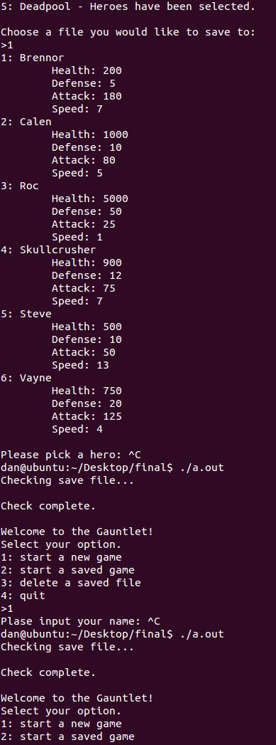
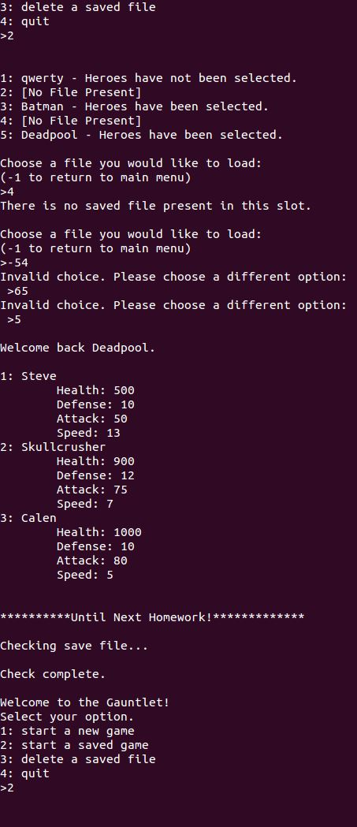
Things you should look for:
The active game with player ‘qwerty’ was interrupted (the ^C, or ctrl + c). However, when checking the saved files, the save file is there for that player.
The save file for ‘qwerty’ has not been created, since ‘qwerty’ has not selected heroes yet.
Selecting a file that has selected heroes simply prints out the heroes that were selected.

Slide 5
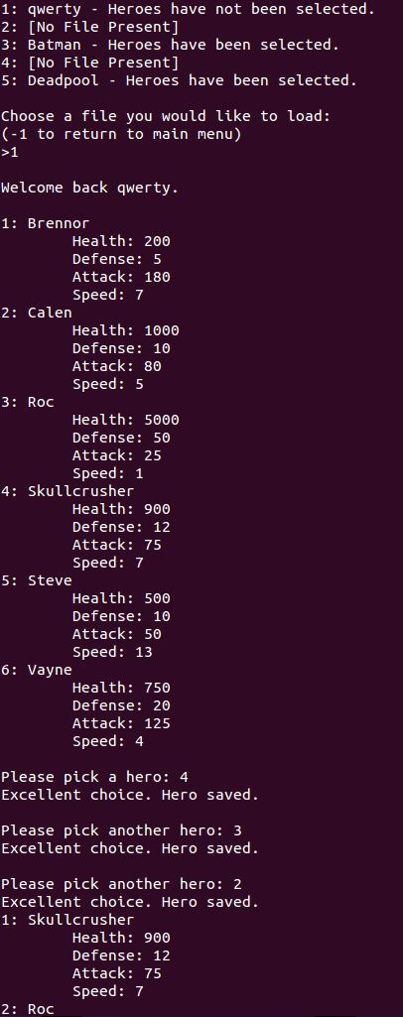
Things you should look for:
The loaded file for ‘qwerty’ goes straight to selecting heroes, and the program continues from there.

Slide 6
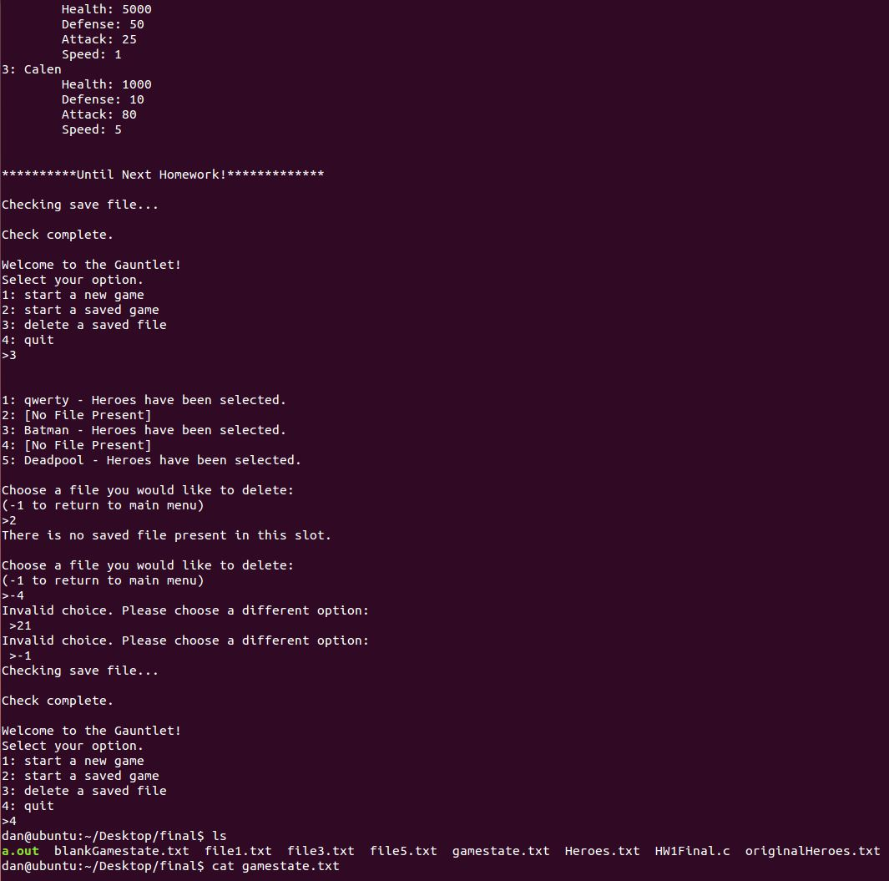
Things you should look for:
At this point, all modules have been tested except for actually deleting a saved file slot
When the files are listed in the folder, the save files are present
There are only save files for the slots that are taken (slots 2 and 4 are open from the slot list above it)
If you were to open any of the save files (e.g. file3.txt), you should see the heroes that Batman selected near the beginning of these slides

Slide 7
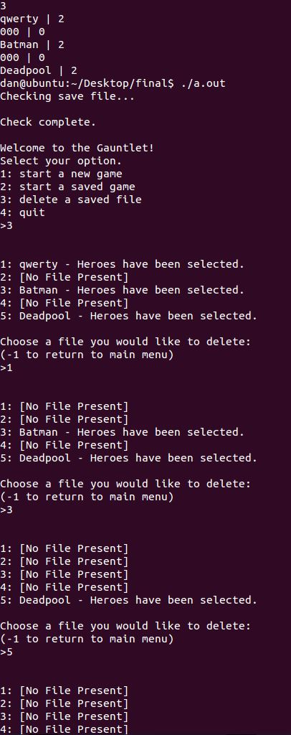
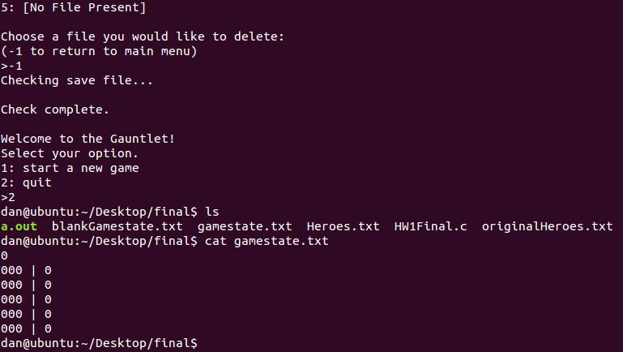
Things you should look for:
The file ‘gamestate.txt’ correctly reflects that slots 1,3, and 5 are taken, with the given names and state values
After save files are deleted, the file ‘gamestate.txt’ has been cleared of the data that was there

